Slide 1

Micro Credit Defaulter Project
CHAGANTI SAI MAHATHI

Slide 2
INTRODUCTION:
Objective: Now a days the prediction of defaulting the borrower in future is a challenging task for credit card companies . Therefore the main objective is to develop prediction models for defaulting the borrower in the future by taking advantage of the available technological advancement
So here we will build a model using classification technique which can be used to predict in terms of a probability for each loan transaction, whether the customer will be paying back the loaned amount within 5 days of issuance of loan. In this case, Label ‘1’ indicates that the loan has been payed i.e. Non- defaulter, while, Label ‘0’ indicates that the loan has not been payed i.e. defaulter.

Slide 3
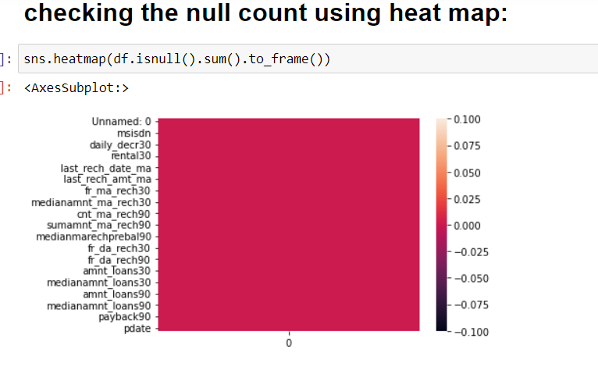
Steps to generate model: >Data Cleaning:
First the shape of the given data set is extracted i.e , (209593,37)
Checking whether the given data set has any null count-there is no null values present in the data set

Slide 4
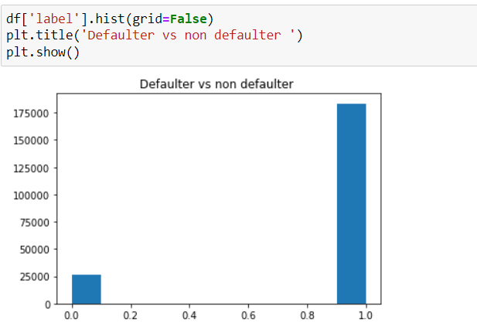
Graphical Analysis:
The dataset is imbalanced. Label ‘1’ has approximately 87.5% records, while, label ‘0’ has approximately 12.5% records

Slide 5
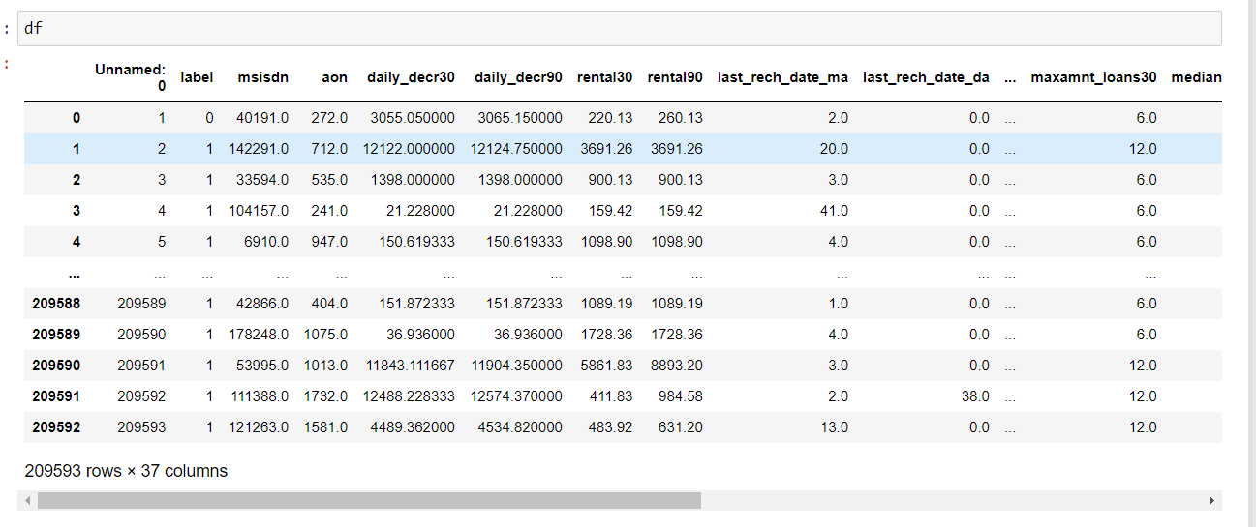
Encoding and Analysing:
Ordinal encoder is used to covert all the object feature variable to numeric data
Heat map is used to check the correlation of all the features with respect to the label variable
Outliers are checked using boxplot .
Encoded data:

Slide 6
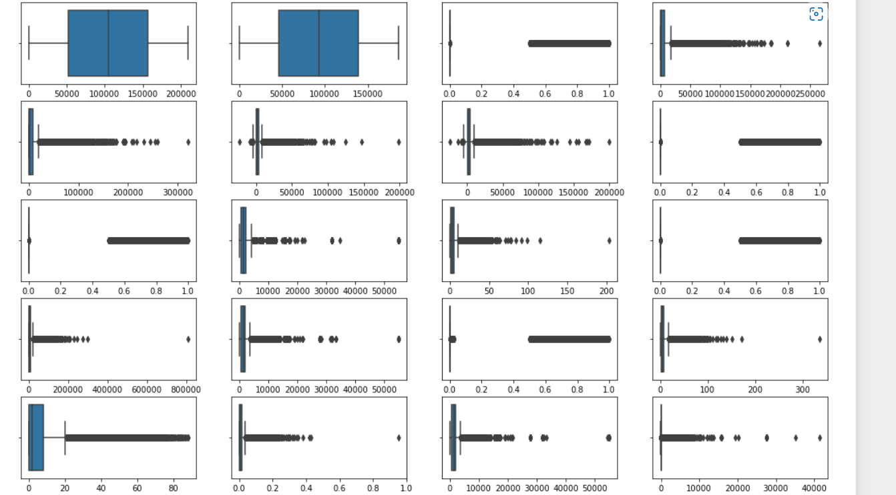
Checking the outliers

Slide 7
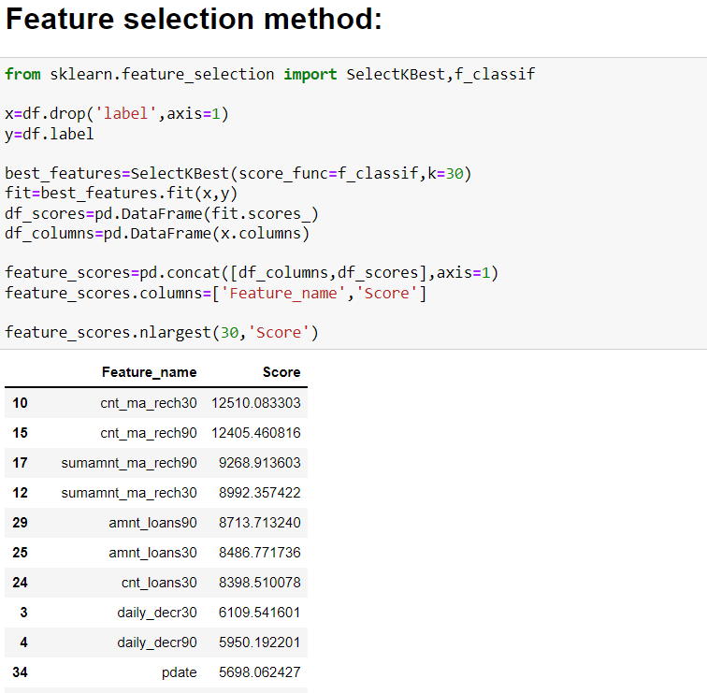
Feature selection method :
Top30 best features are selected using feature selection method.

Slide 8
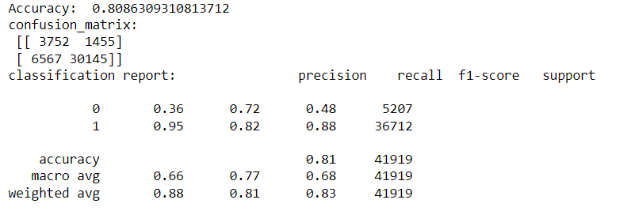
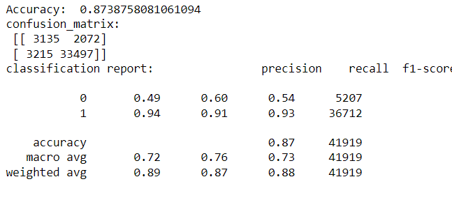
Model building:
KNeighborsClassifier:
DecisionTreeClassifier:

Slide 9
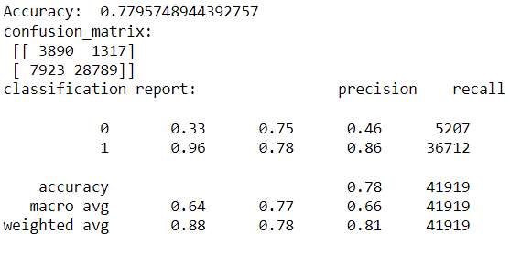
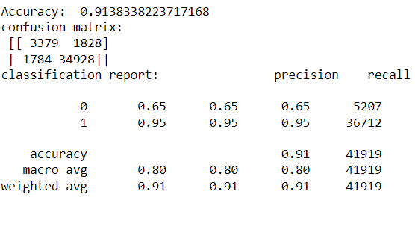
Model building:
Logistic Regression:
Random Forest Classifier:

Slide 10
Conclusion:
After Hyper parameter tuning and model prediction “Random forest Classifier”with accuracy score of 91.38% is considered to be the best model compared to the other models so this model is saved and can be used for future prediction.

Slide 11
Thank you

